Slide 1
GSS Conference 2016 Connect. Collaborate. Create
Data driven collaboration in Local Communities
Sandra Tudor
Deputy Director
Data, Analytics and Statistics Division
Ric Roberts
Chief Technology Officer
Swirrl IT Ltd

Slide 2




Data and statistics at DCLG (1)
DCLG’s objectives
Cross-cutting issues and challenges
Driving up housing supply
Increasing home ownership
Delivering efficiencies (internally and externally)
Understanding and managing complex policy dependencies
Open, trusted engagement with a broad and diverse stakeholder community
The “place” dimension
Supporting strong communities with excellent public services
Devolving powers and budgets to boost local growth in England

Slide 3
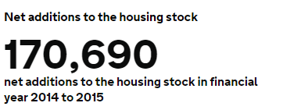
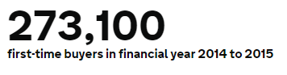
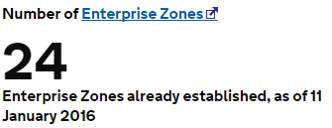
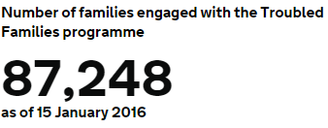
Driving up housing supply
Data and statistics at DCLG (2)
DCLG collects and produces a range of (mainly) Local Authority level statistics on Housing, Planning, and Local Government Finance
56 Statistical Releases per year and around 100 publications
We are also responsible for significant administrative datasets, e.g.:
Register of 15 million+ domestic and non-domestic Energy Performance Certificates
Planning Appeals Casework
We are a significant contributor to data.gov.uk.
And we are actively working to improve our data and intelligence for policy development and partnership working.
Unlike many other Central Departments, we do not provide high-volume transactional services.
But we are responsible for Local Government, which (as a sector) delivers significant transactional services to the public.
Increasing home ownership
Devolving powers and budgets
strong communities

Slide 4
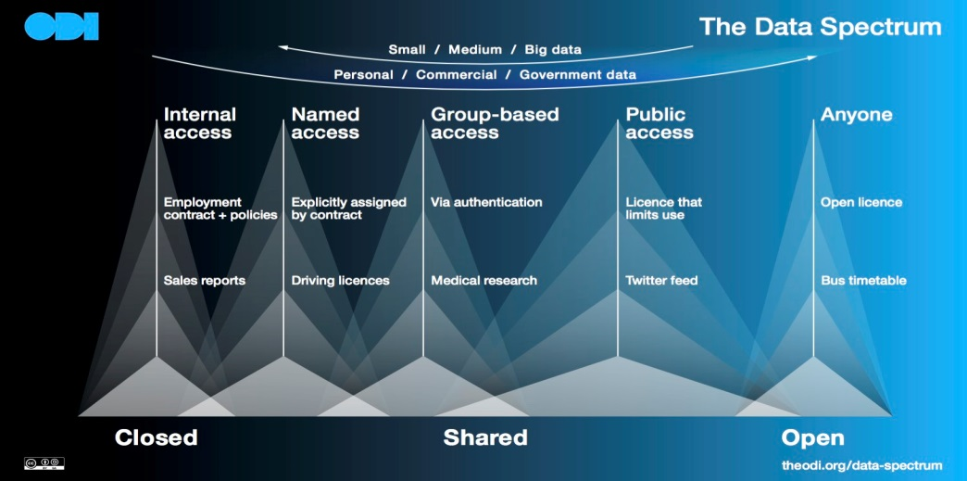
Open Data: what is it?
“Open data and content can be freely used, modified, and shared by anyone for any purpose”
Source: Open Definition - http://opendefinition.org/
Important to recognise Open Data’s position in the Data Spectrum.
Source: Open Data Institute- http://theodi.org/data-spectrum
Data is infrastructure. It underpins transparency, accountability, public services, business innovation and civil society. Data such as statistics, maps and real-time sensor readings help us to make decisions, build services and gain insight.
Source: Open Data Institute - http://theodi.org/what-is-data-infrastructure

Slide 5
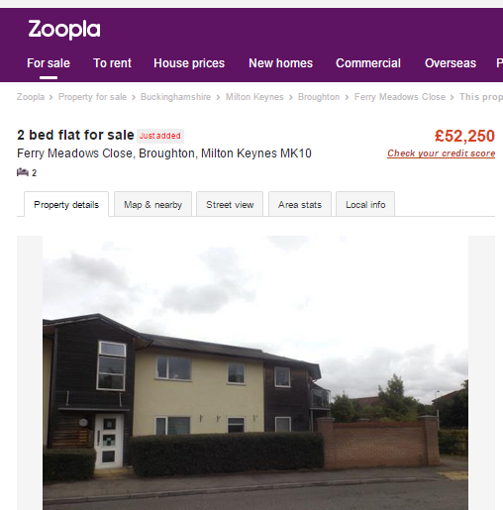
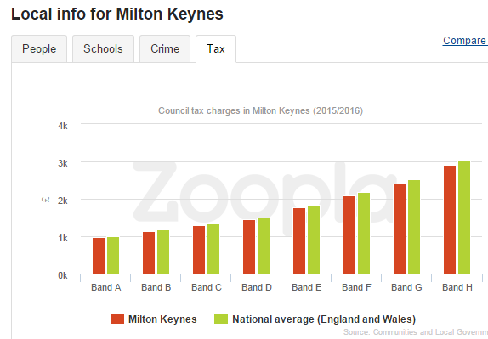
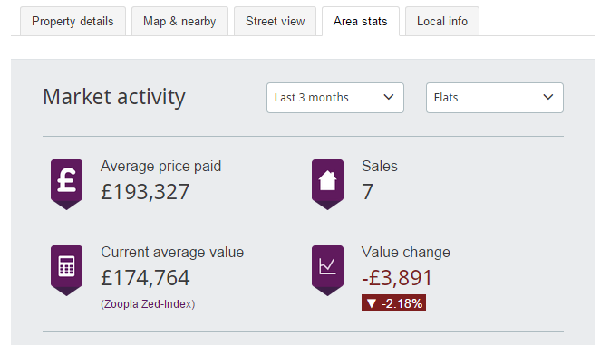
Data as infrastructure: what could it look like?
Local Housing markets
Re-uses DCLG’s Council Tax statistics
Zoopla’s own analysis, but potentially v useful new insight for DCLG to monitor local housing markets
Source: http://www.zoopla.co.uk/

Slide 6
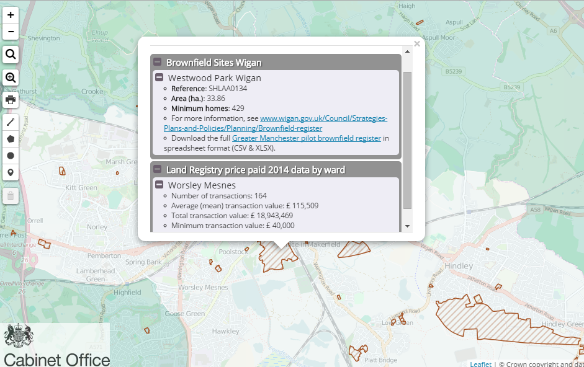
Data as infrastructure: what could it look like?
Local Land and Development opportunities
Built by councils forming the Greater Manchester Local Enterprise Partnership
Provides consistent GM-wide view of various local and national sources.
Source: http://mappinggm.org.uk/gmodin/

Slide 7
Open Data (as infrastructure): Why it matters
Open Data (as infrastructure)
=
Improved accountability for public service delivery, with greater citizen and community participation
More consistent and extensive evidence to transform service design and commissioning
New knowledge and insights, to power better collaborative working and decision-making
Robust and trusted data to power innovative new tools and applications
Cost savings, and cost avoidance
Improved quality
Open is good.
Open and inter-linked (via the data infrastructure) is better.
How to make our statistics available in this infrastructure
How to ensure outputs remain relevant and actively used (particularly alongside new sources)
But
Notes:
Questions:
How to unlock DCLG’s data and statistics on housing markets, so it is available to users in a more accessible and inter-linked form?
How to build new relationships with 3rd party data providers (like Zoopla), to acquire and link their sources to our existing evidence-base?
How to ensure that our statistical products are incorporated and used in tools like GM-ODIN?
What is the stats community’s role in supporting and encouraging development of similar tools for other localities, and different problems/issues?

Slide 8
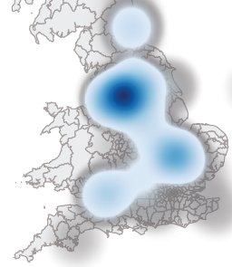
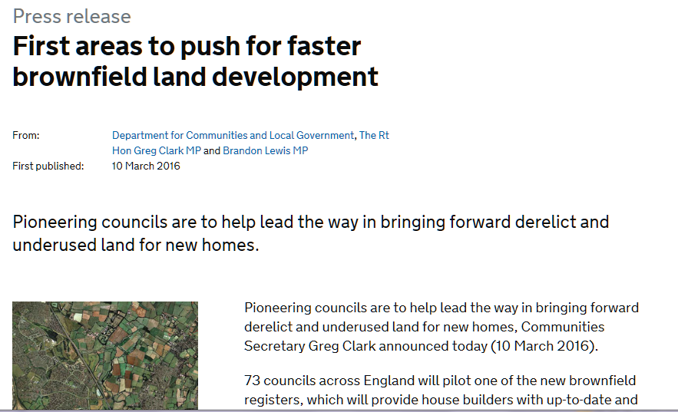
Progress to date: some examples
Local Brownfield Registers
Map illustrating concentration of potential new dwellings on brownfield land. Based on local registers published by 52 Local Authorities participating in pilots. Covers 4,121 brownfield sites.

Slide 9
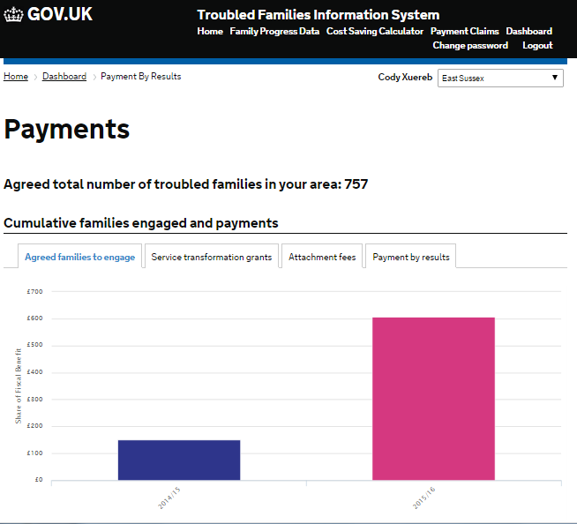
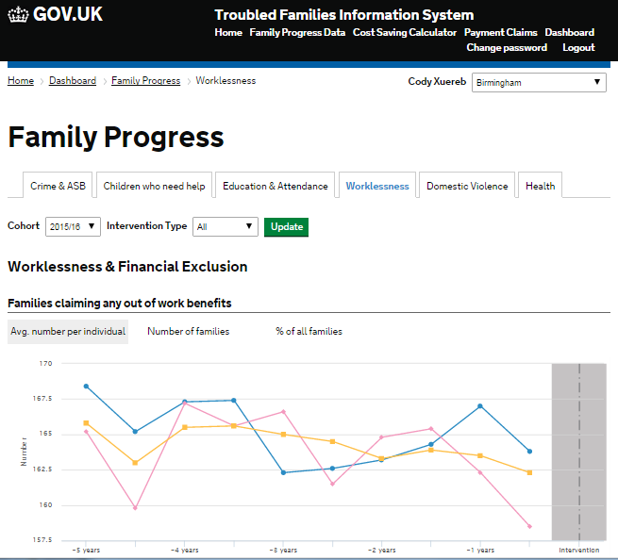
Progress to date: some examples
Improving data-driven partnerships working
A single point of access for LAs to submit their Troubled Families data and information.
Simple and easy to use dashboards: with robust and credible data on participating family characteristics and outcomes of families, plus local cost benefit analyses.
Supports local service transformation ambitions by providing information about changes in outcomes locally and comparisons to the national average and statistical nearest neighbours
Enables LAs to download key data and information in a range of accessible formats to inform local conversations with partners, management boards and others.
Notes:
overall and the outcomes of specific interventions being used to support local commissioning decisions locally.

Slide 10
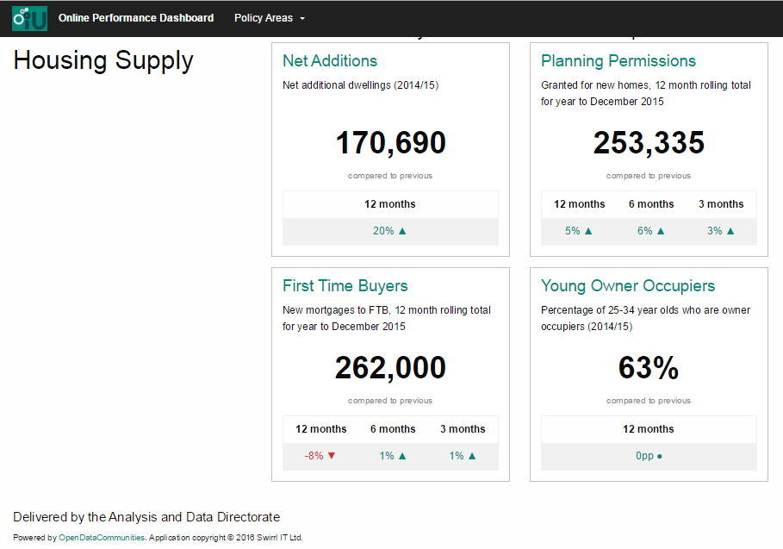
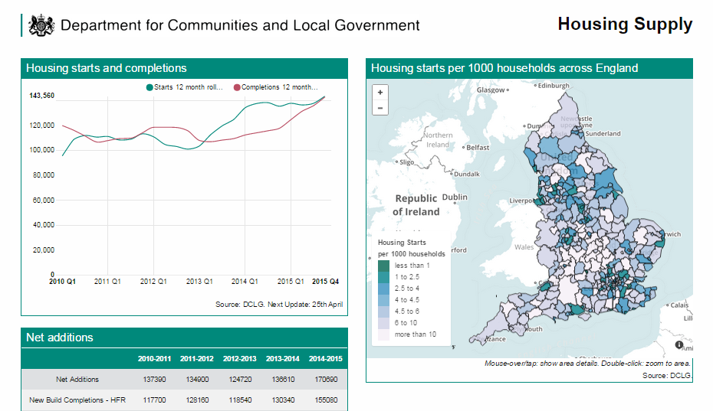
Progress to date: some examples
Monitoring DCLG policy outcomes
Monitors strategic priorities and policy
Powered by open data
Readily accessible consumable departmental data and statistics
Eases report burden and overhead
Drives the “data culture”

Slide 11
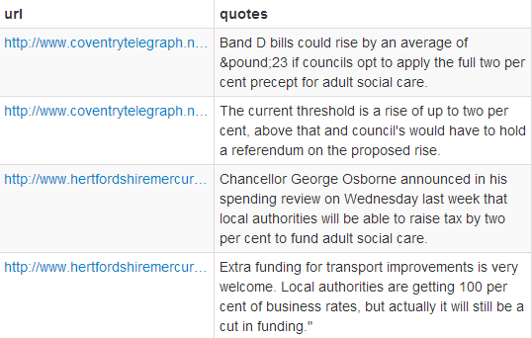
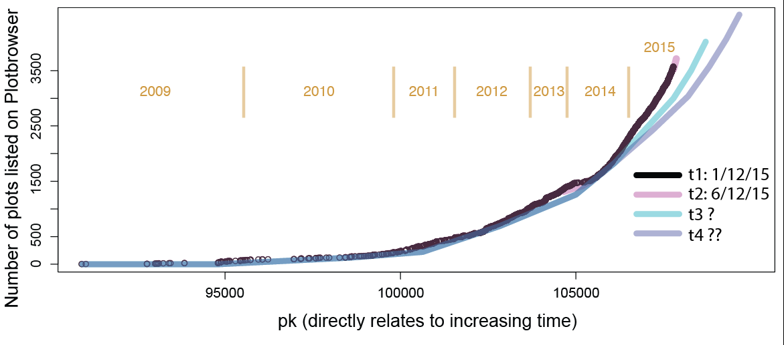
Progress to date: some examples
Improving skills and capability
DCLG’s Code Club is helping to disseminate new ways of utilising and analysing data
Enthusiastic teams of volunteers participate in competitions identified from business needs
Building our Data Science capability and skills through “doing”
Monitoring local authority council tax intentions by scraping news stories
Tracking the number of self and custom builds by scraping and analysing plot data and cross referencing with additions and removals

Slide 12
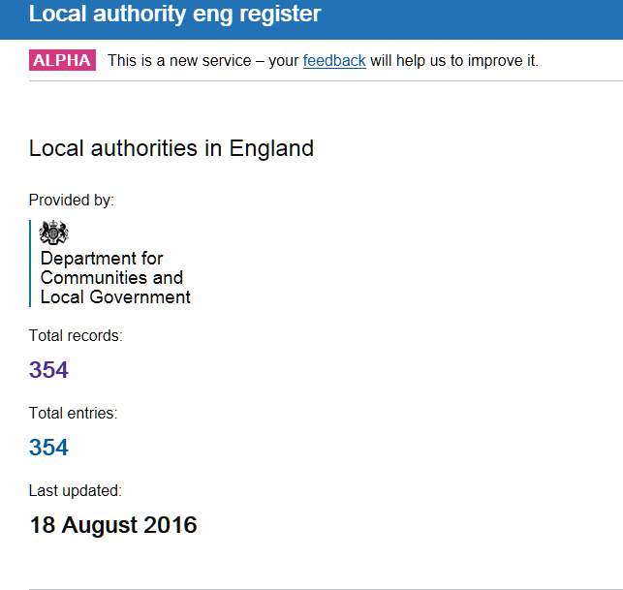
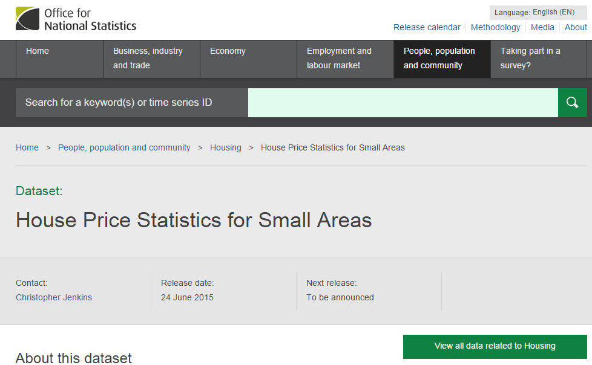
Progress to date: some examples
data
Collaboration, to build the data infrastructure
We are collaborating with GDS on a new, definitive register of UK Local Authorities
We are collaborating with ONS and other UK territories to begin trialling new UK-wide standardised, inter-linked and accessible data about housing markets at different spatial scales.

Slide 13
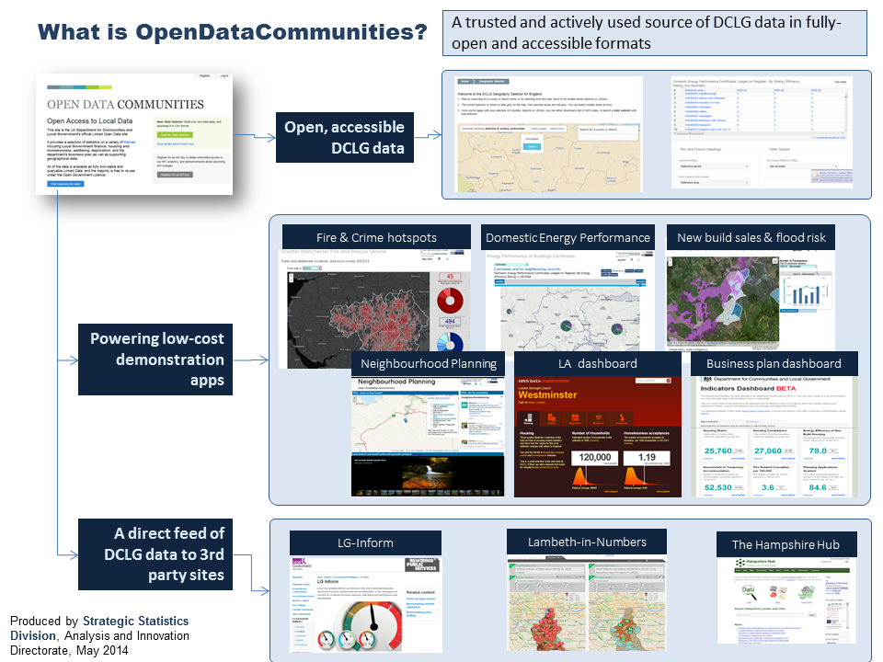
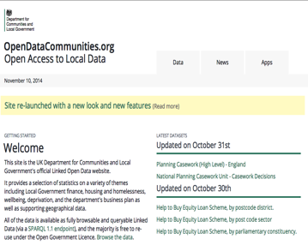
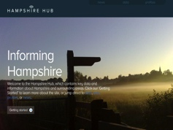
Building the infrastructure foundations
OpenDataCommunities
Tools for you to combine and extract data for your places of interest
DCLG datasets in 5-star formats
Apps by us, to demonstrate the power and potential of open, linked data
Apps by others, re-using DCLG data alongside other sources
http://opendatacommunities.org
Notes:
Currently, OpenDataCommunities comprises around 170 DCLG datasets. We have a mixture of statistics on housing, planning and Local Government finance; detailed data on services provided by individual councils; and information on registered providers of social housing.
We’ve worked closely with partners and users (including Mark) to ensure we’re providing what users want, in the most accessible and useable forms. This has resulted in tools for the non-technical user to quickly access, link together and extract data about particular places – e.g. to retrieve everything we know about Eastleigh.
Alongside these tools, we’ve developed various low cost applications which illustrate the art of the possible around visualising data in new/interesting ways, and linking it to third party sources. The point here is to stimulate interest from others to develop new/innovative tools. This is happening – e.g. through our work with innovators delivering new mobile applications for the housing rental market.
Finally, and most importantly, we’re working with the local sector to ensure that OpenDataCommunities can provide data on demand, for use within local sites alongside non-DCLG sources. Currently, we are providing data feeds to LGA’s LG-Inform service, to support local performance benchmarking. We are working with Hampshire Hub to blend DCLG and local data about and for this locality.

Slide 15
opendatacommunities.org

Slide 16
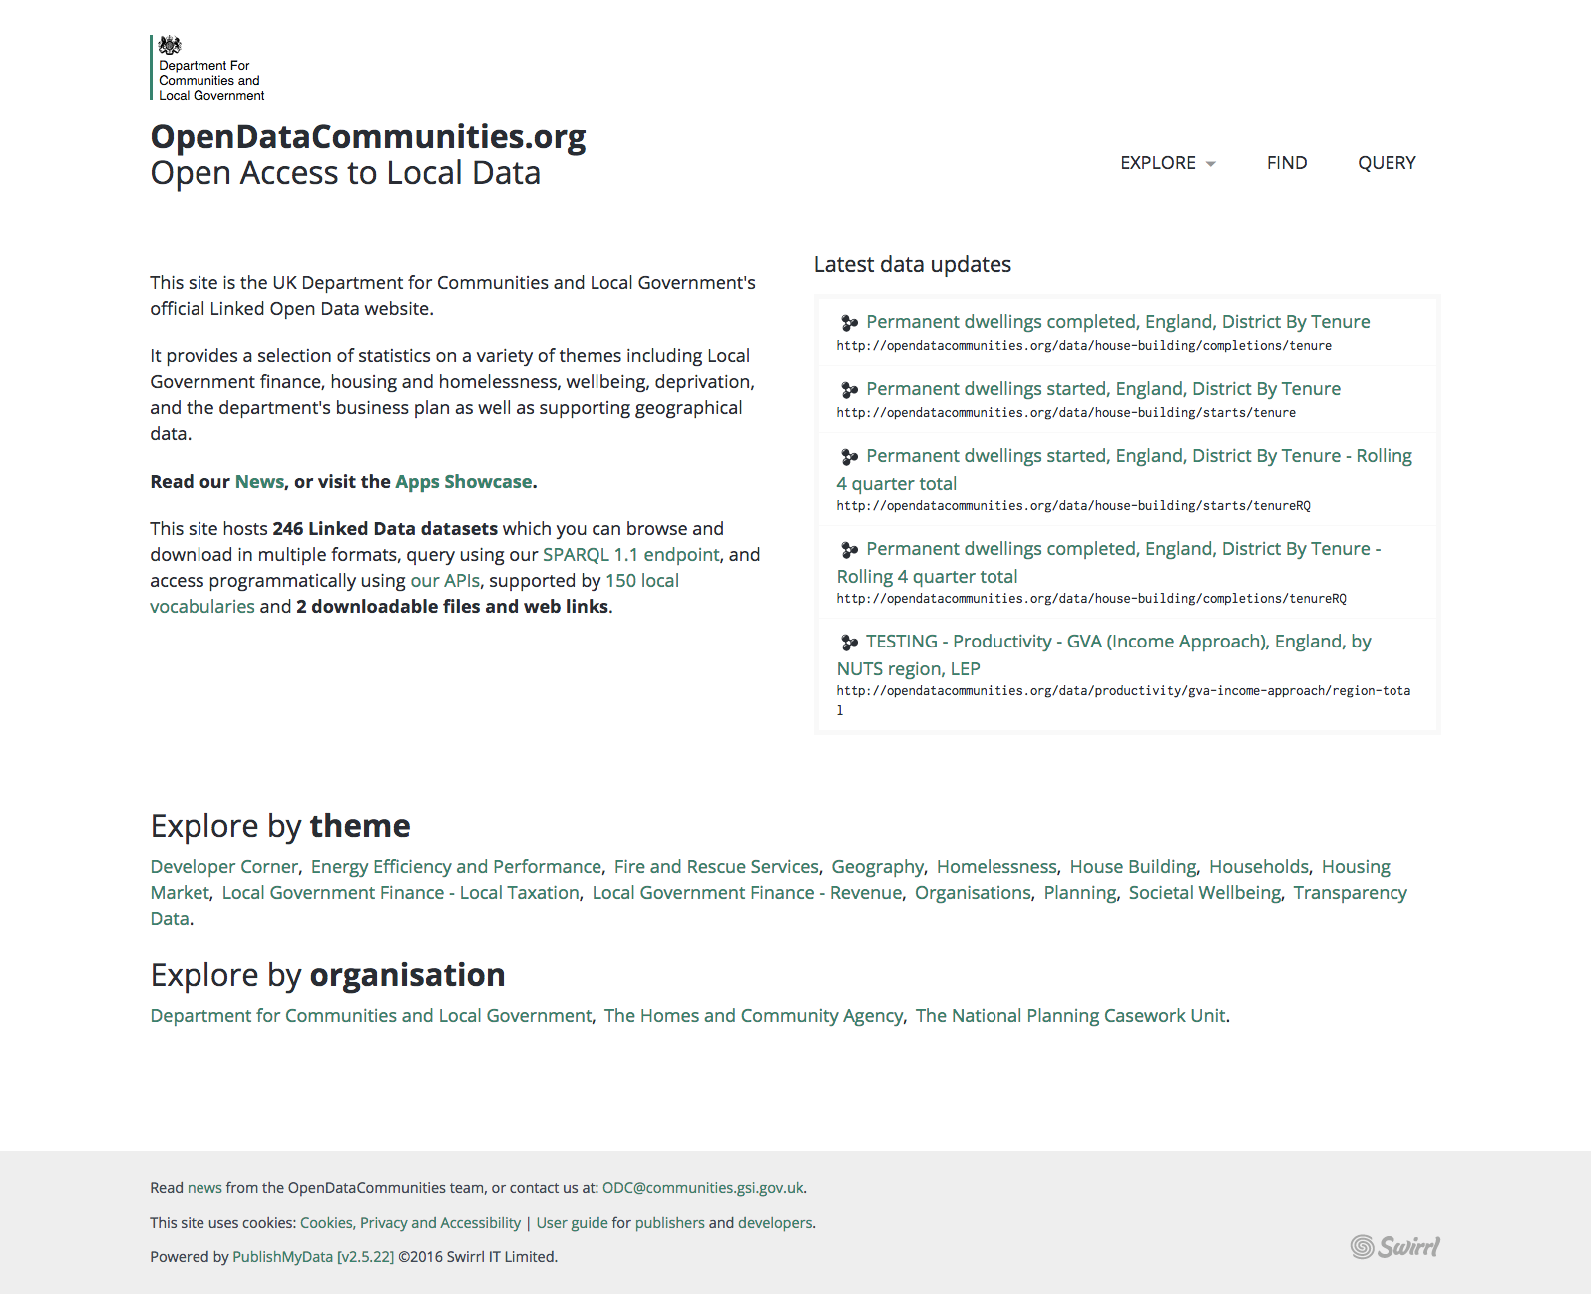

Slide 17
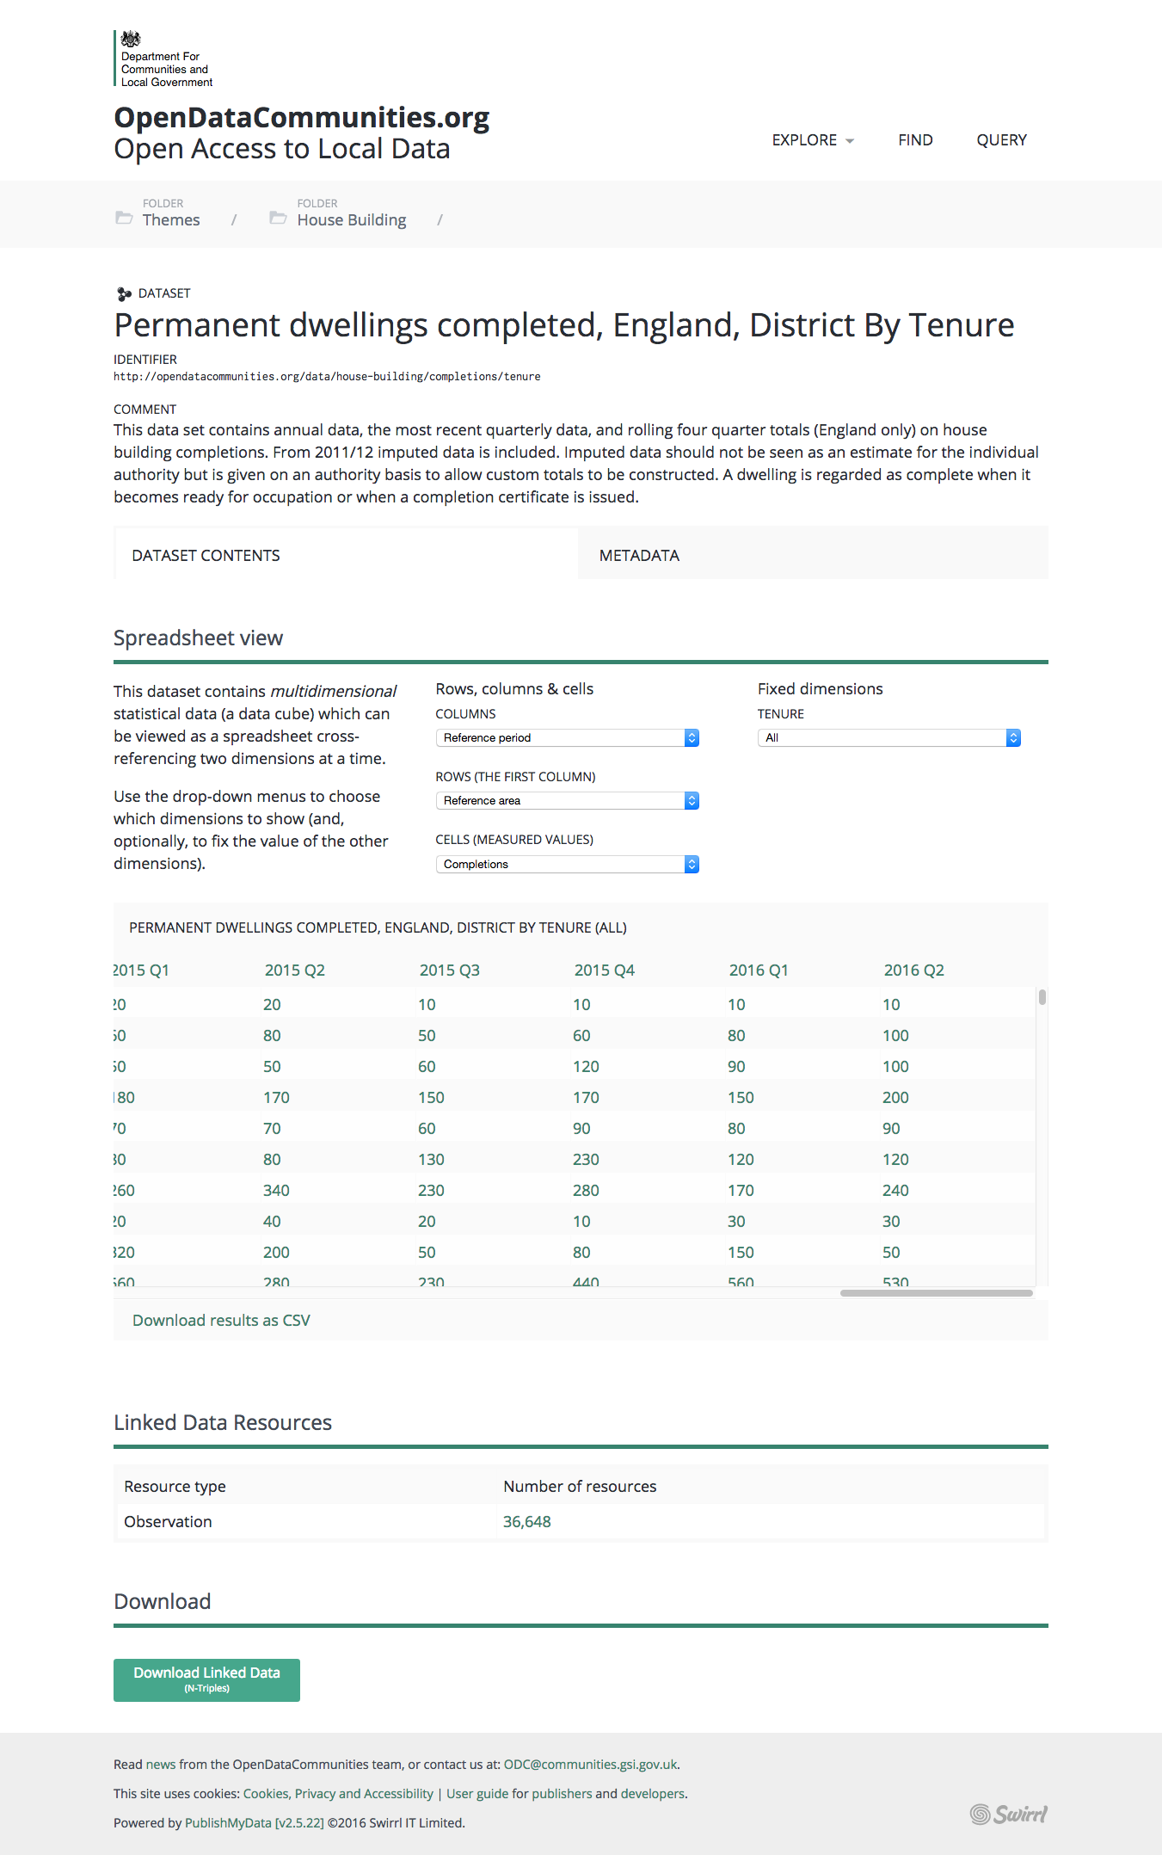
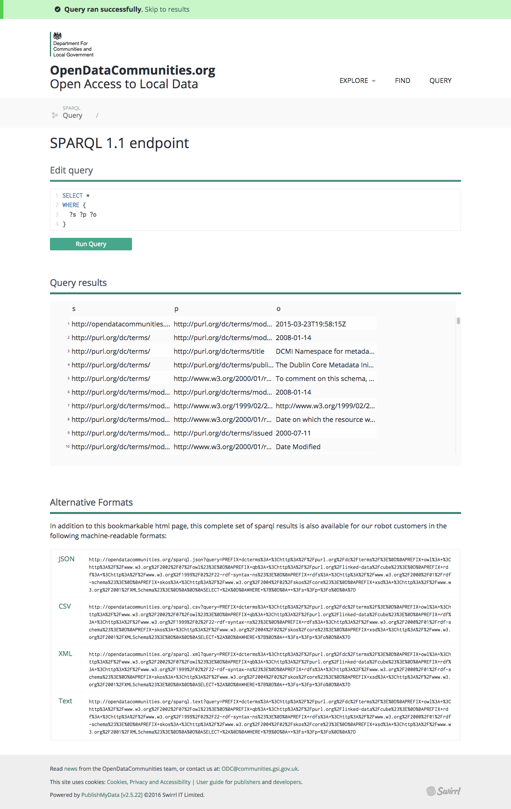

Slide 18
who is it for?

Slide 19
who is it for?
nerds, kinda

Slide 20
who is it for?
DCLG

Slide 21
who is it for?
developers

Slide 22
who is it for?
you

Slide 23
what is it?

Slide 24
what is it?
free, open, queryable, authoritative, definitive, permanent,
citable, convenient

Slide 25
how is it done?
built with the PublishMyData platform

Slide 26
technology
linked data

Slide 27
triple = subject + predicate + object

Slide 28
HM The Queen’s birthday is 21 April

Slide 29
HM The Queen’s birthday is 21 April

Slide 30
HM The Queen’s birthday is 21 April

Slide 31
HM The Queen’s birthday is 21 April

Slide 32
subject: The Queen
predicate: birthday
object: 21 April

Slide 33
use URIS
*Uniform Resource Indicators

Slide 34
subject
https://www.royal.uk/data/her-majesty-the-queen

Slide 35
predicate
http://xmlns.com/foaf/0.1/birthday

Slide 36
predicate
foaf:birthday

Slide 37
object
21 April

Slide 38
https://www.royal.uk/data/her-majesty-the-queen
foaf:birthday
21 April

Slide 39
graph data

Slide 40
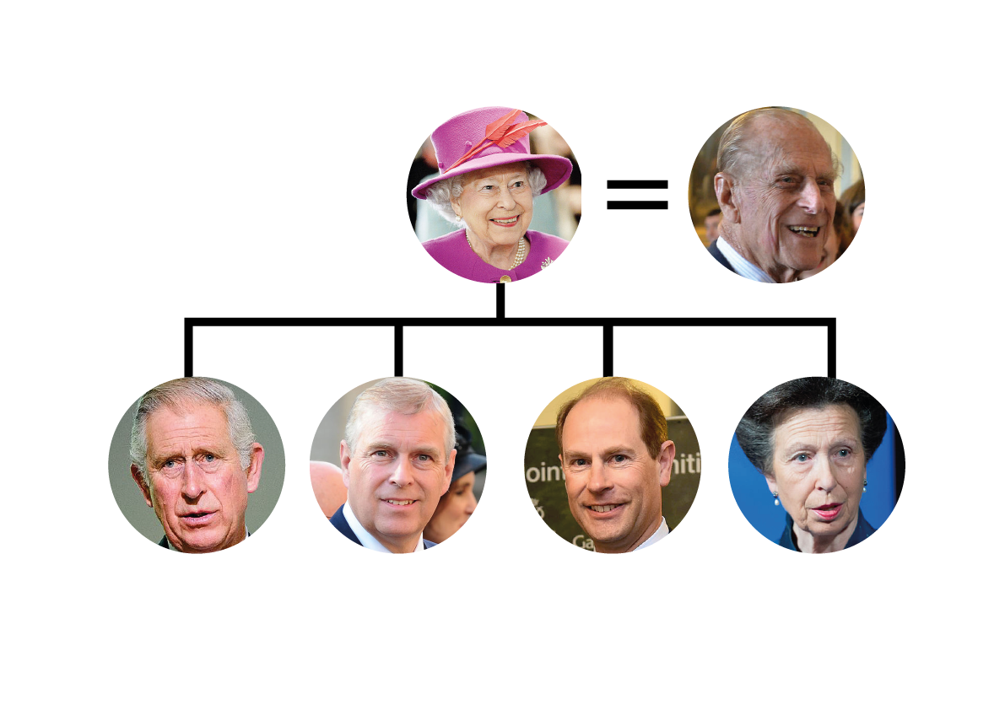

Slide 41
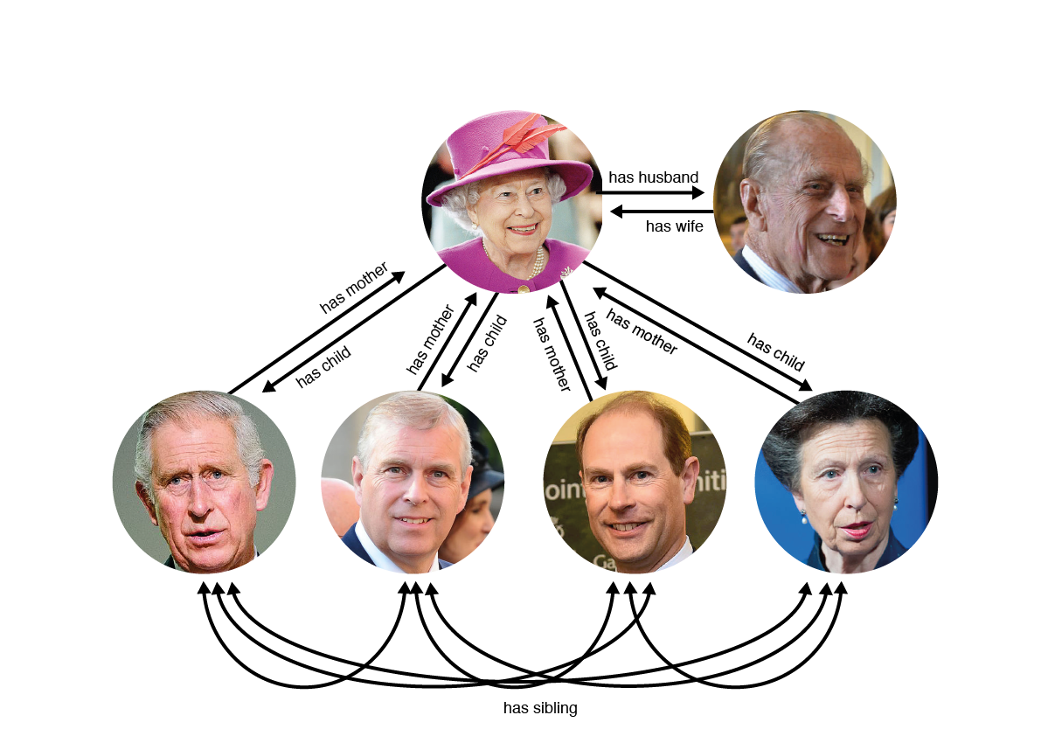

Slide 42
(we couldn’t get any royalty-free photos)

Slide 43
linked data pro & con

Slide 44
linked data pro & con
+ self-describing

Slide 45
linked data pro & con
+ open, transparent
+ standards-based

Slide 46
linked data pro & con
+ machines & humans

Slide 47
linked data pro & con
+ interoperable

Slide 48
linked data pro & con
+ futureproof

Slide 49
linked data pro & con
- hard to publish

Slide 50
linked data summary + the best format
- can be hard work

Slide 51
pieces of the puzzle

Slide 52
pieces of the puzzle graph store

Slide 53
pieces of the puzzle
edit / transform / load

Slide 54
pieces of the puzzle integration with
your existing systems

Slide 55
pieces of the puzzle
drafting - preview - approval workflow

Slide 56
pieces of the puzzle
browse / search / combine tools

Slide 57
pieces of the puzzle
apis / endpoint

Slide 58
pieces of the puzzle
advocacy, imagination

Slide 59
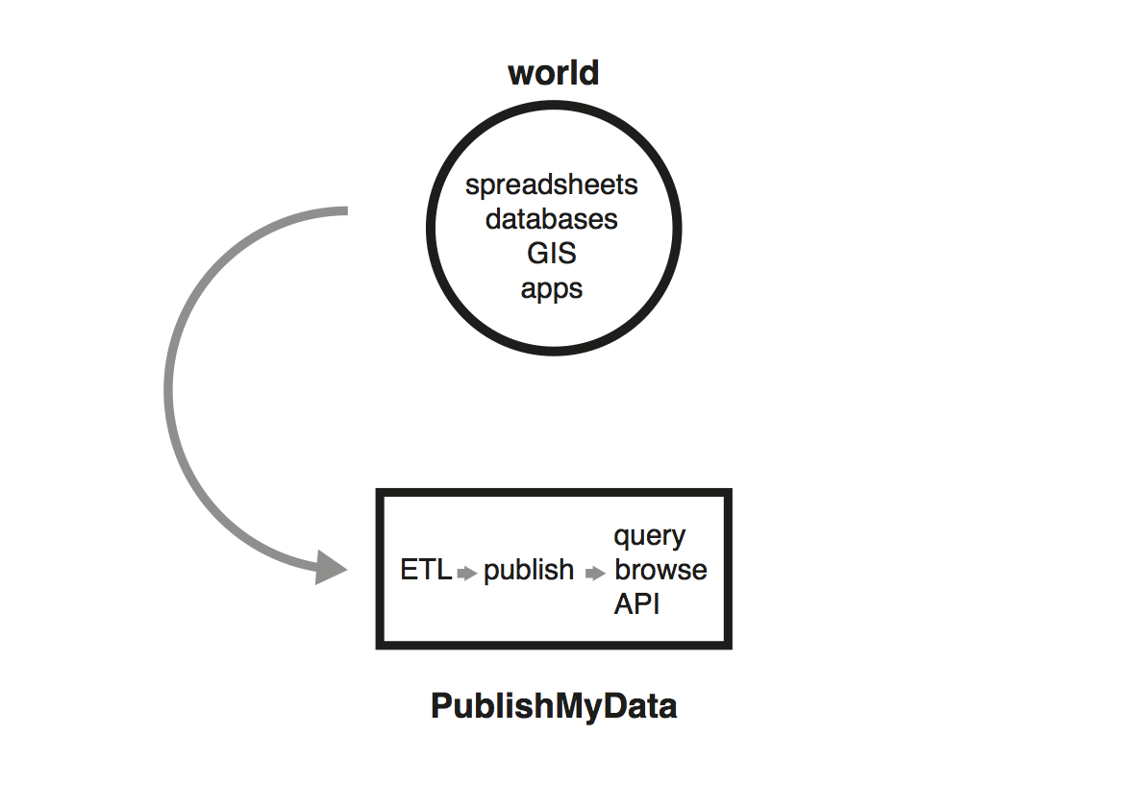

Slide 60
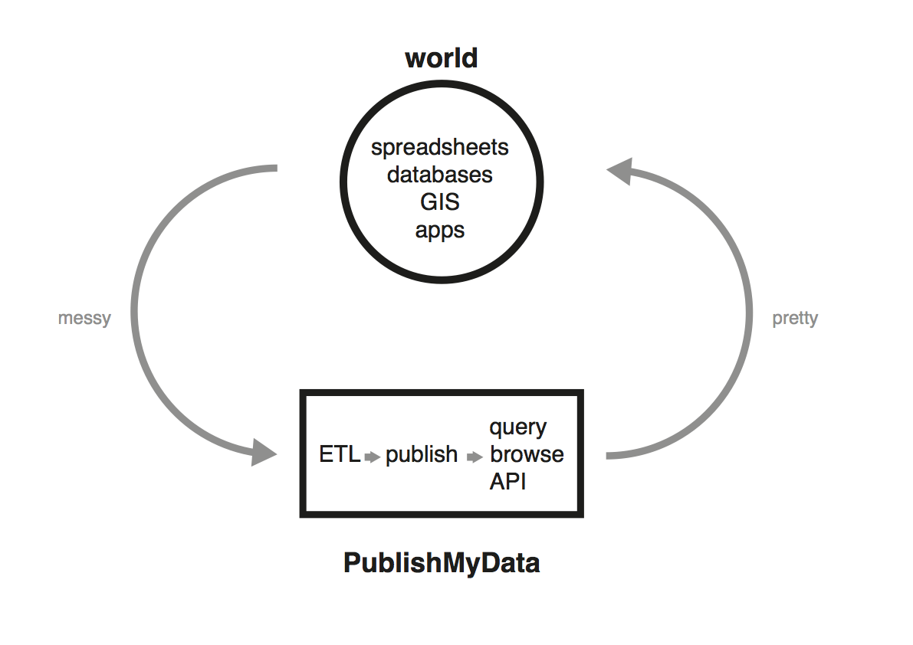

Slide 61
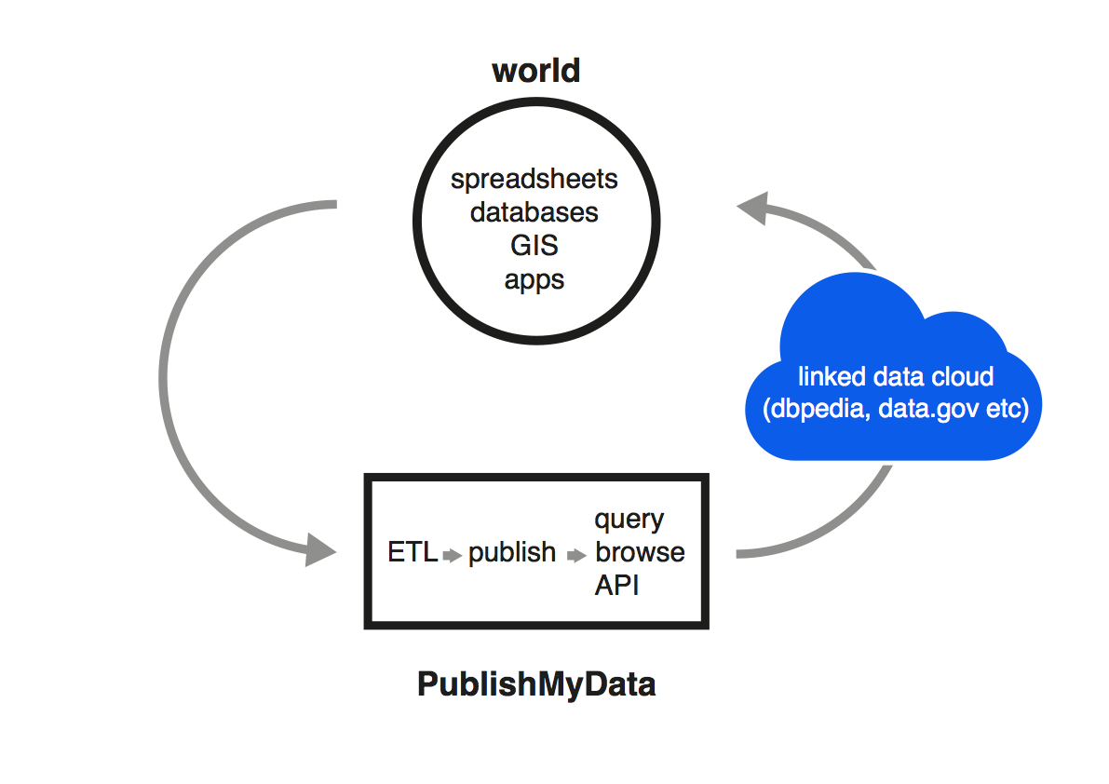

Slide 62
what can we do which we couldn’t otherwise?

Slide 63
apps
http://apps.opendatacommunities.org/

Slide 64
Index of Multiple Deprivation tools

Slide 65
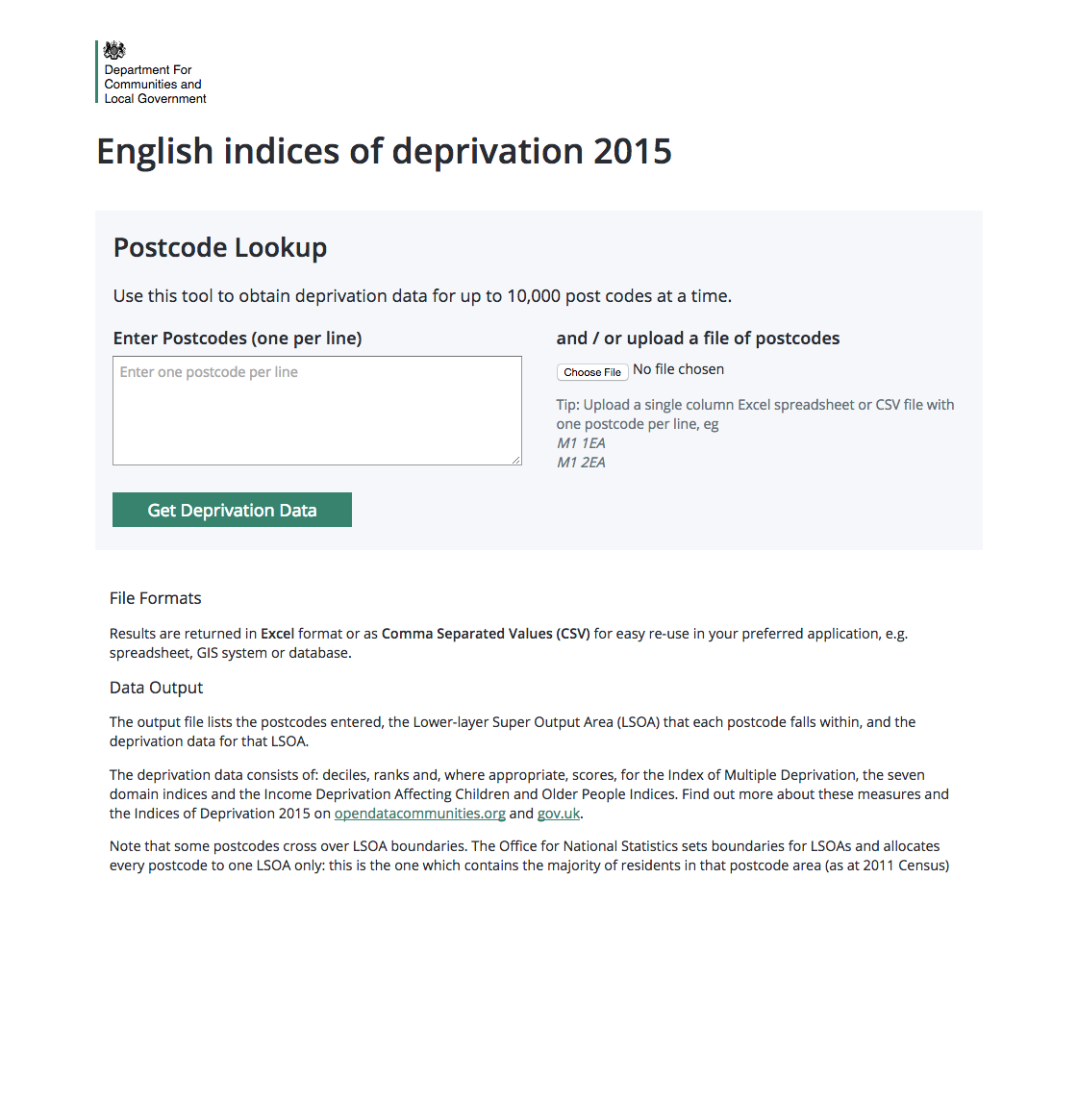
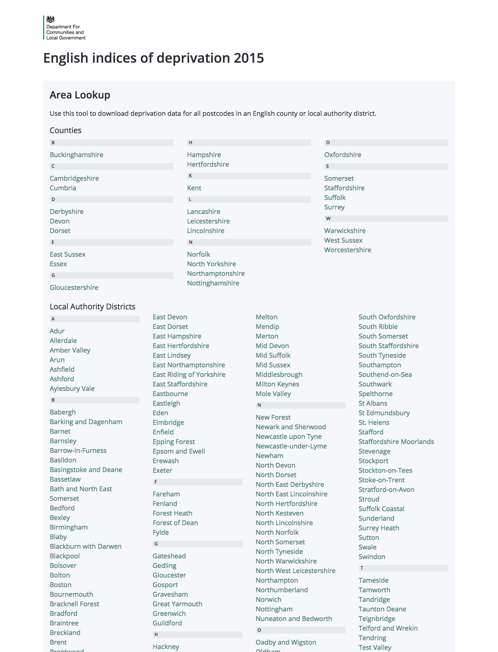

Slide 66
IU dashboard

Slide 67
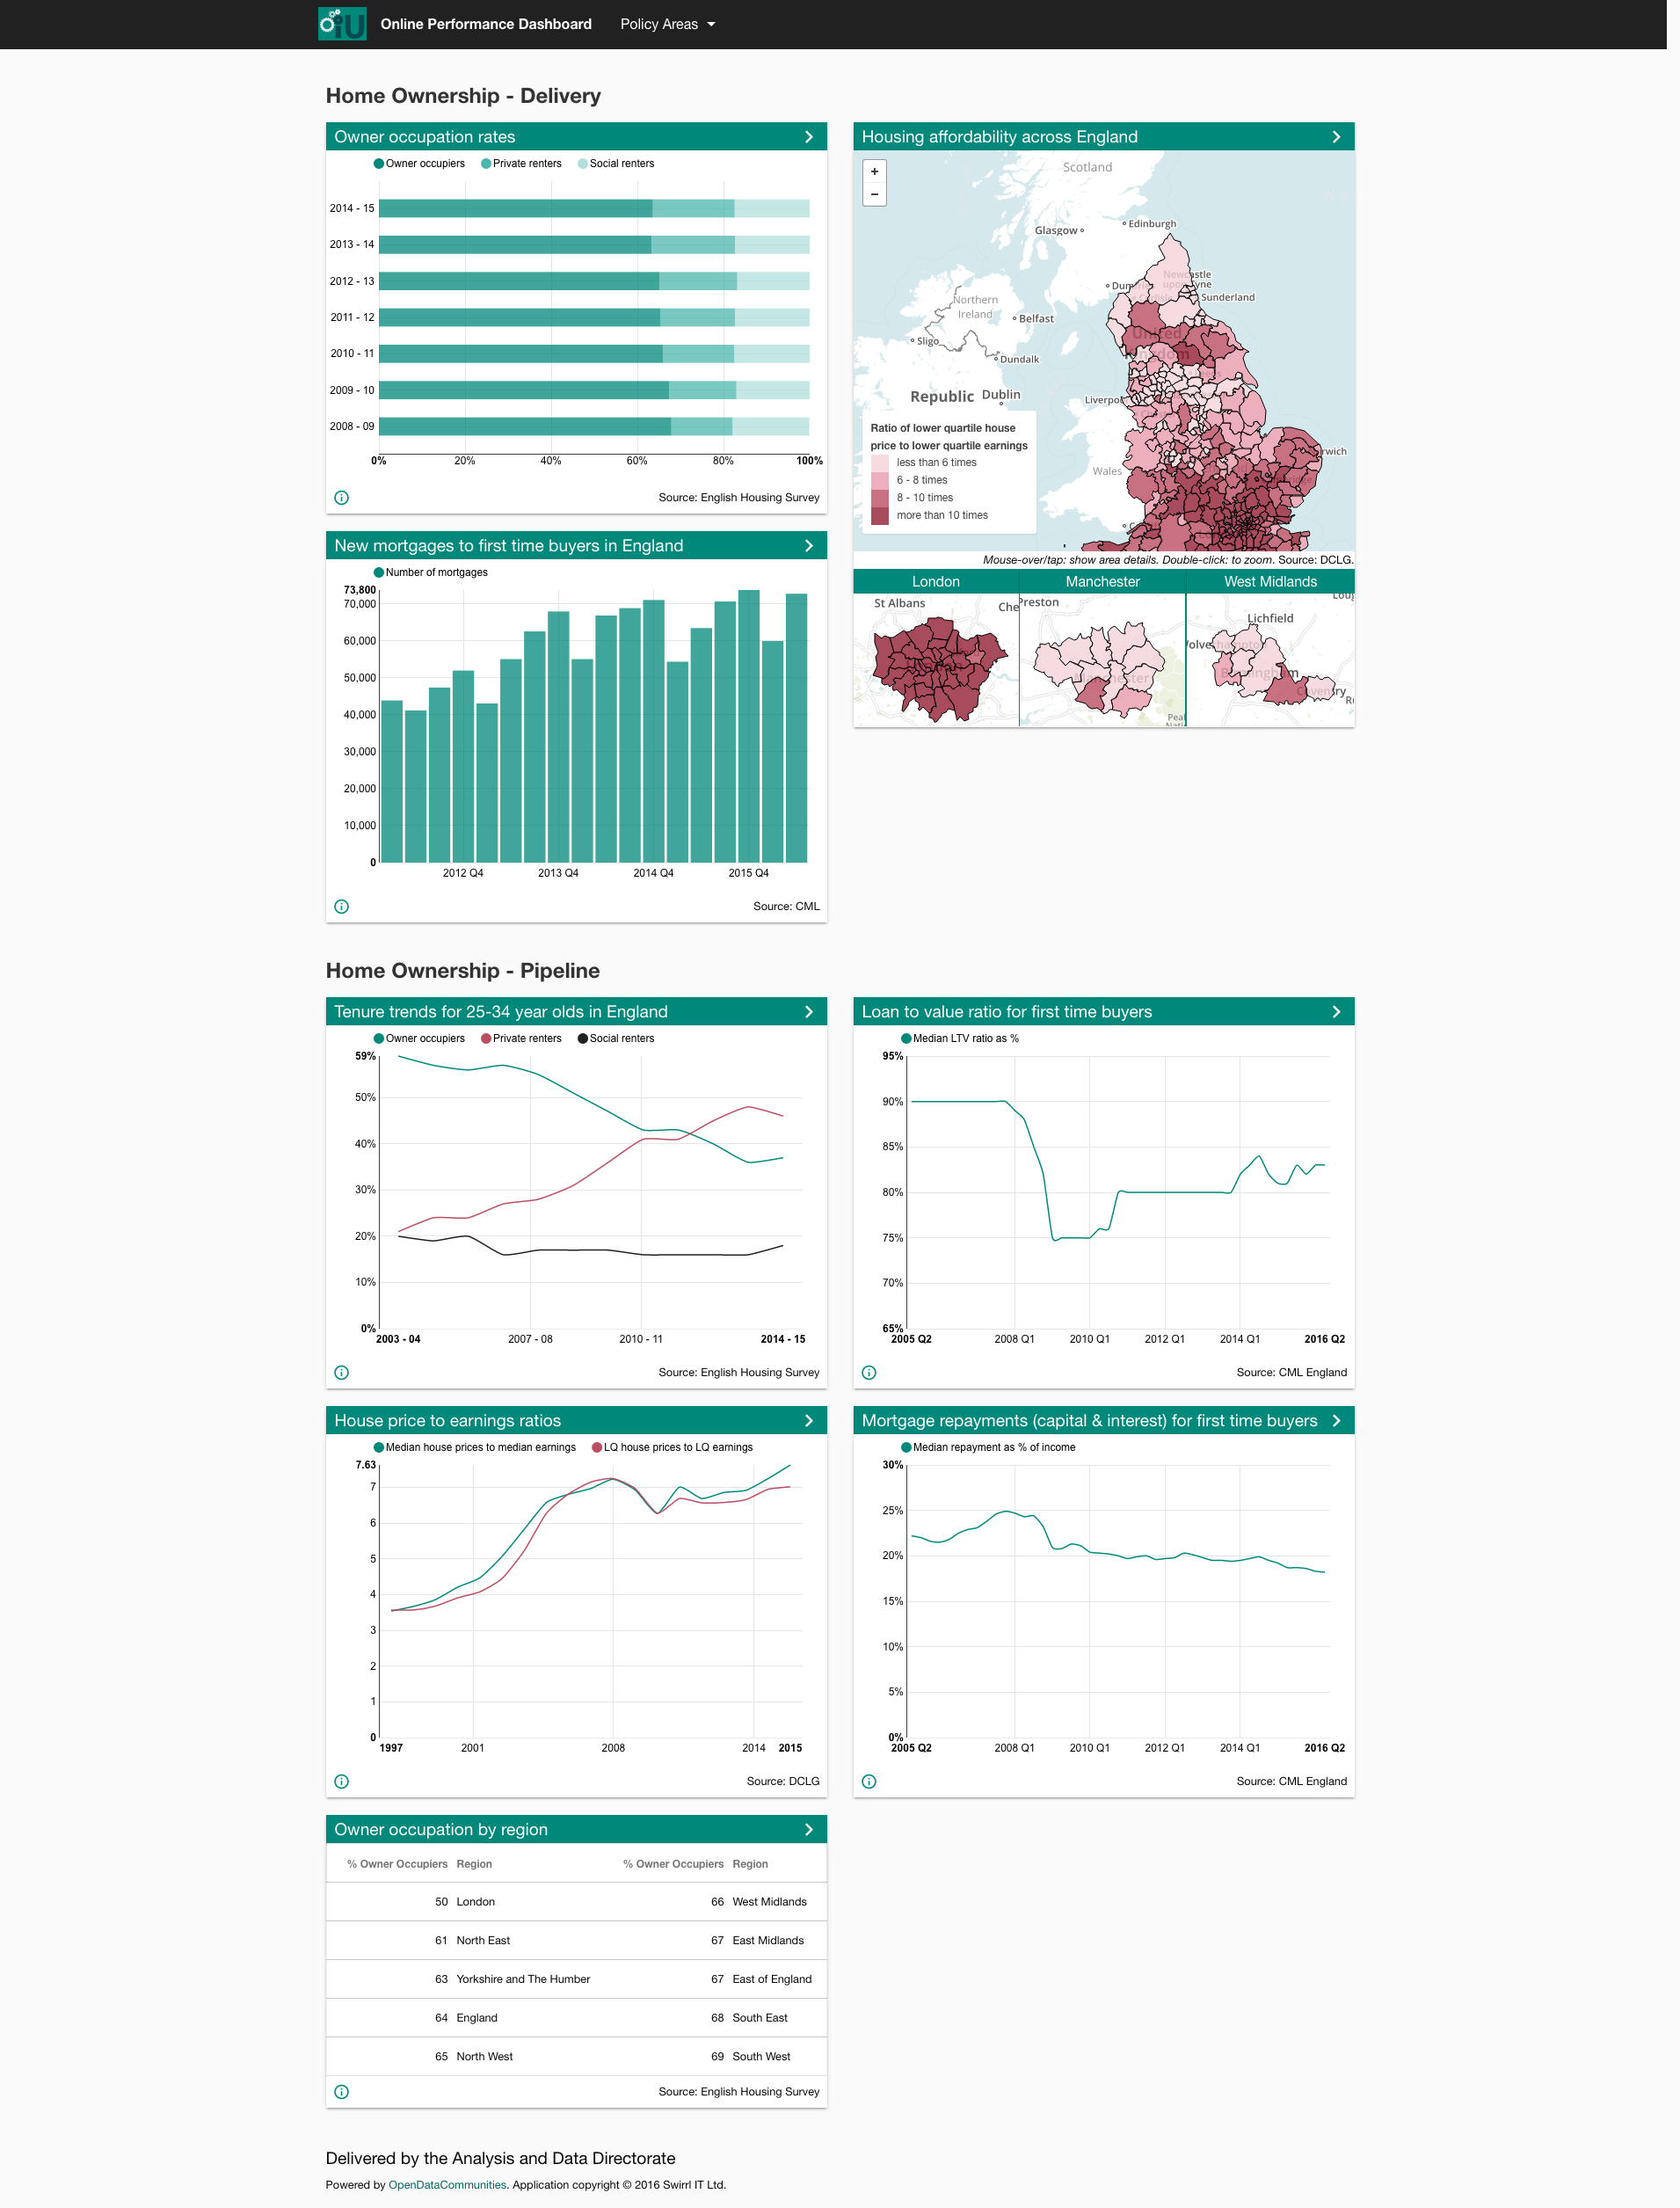

Slide 69
coming soon

Slide 70
coming soon
data cart

Slide 72
coming soon
cube dive

Slide 74
OpenDataCommunities
Future priorities, and issues
Use
Expand
Link
Embed ODC within and across DCLG to underpin policy design, delivery and monitoring.
Involves extending range of web-based performance management and analytical tools.
Also new direct data feeds (APIs) to established tools – such as R, ArcGIS etc.
Continue to grow and open data content in response to user-demand.
Significant new data on Energy Performance of buildings due in October.
Continue collaboration with GDS to deliver LA register.
Also, partnerships with ONS to link and integrate DCLG statistics with related 3rd party sources.
Involves developing standards to enable data linking at scale, in a robust, reliable and trusted manner.

Slide 75
Thank you
Sandra.tudor@communities.gsi.gov.uk
www.opendatacommunities.org
www.gov.uk/dclg
ric@swirrl.com
@ricroberts
www.swirrl.com

